Slide 1
4Sight User Guide
September 10 2021

Slide 2

Table of Contents
About
General Navigation
  Login Page
  Landing Page
  Dropdown Menu
  Elements
  Edit Details
  Add New Records
  Show Search / Advanced Search
  Additional Functionality
Purchase Request Module
Asset Module
Tasking Module
Positions Module
Training Module
Quality Module
Risk Module
ROM Module
Transportation Module
Survey Module
Travel Module
Document Library
Dashboards & Reporting Module
Additional Information
  Account Setup
  Notifications from Optasia
  Escalations

Slide 3
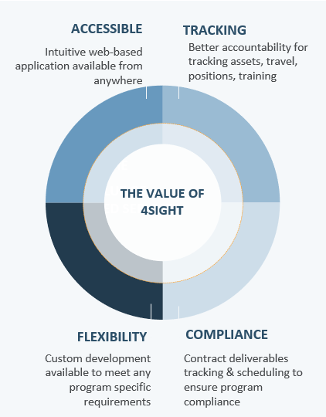
About
4Sight is a GDIT developed and owned portfolio of products with interconnected scalable and secure program solutions to meet the needs of program management, program measurement, and knowledge management. 4Sight provides project and program managers with modules and applications to gather and store team and asset information, as well as superior analysis tools and reporting structures for action decisions, quality assurance compliance, and trend analysis.

Slide 4
General Navigation

Slide 5
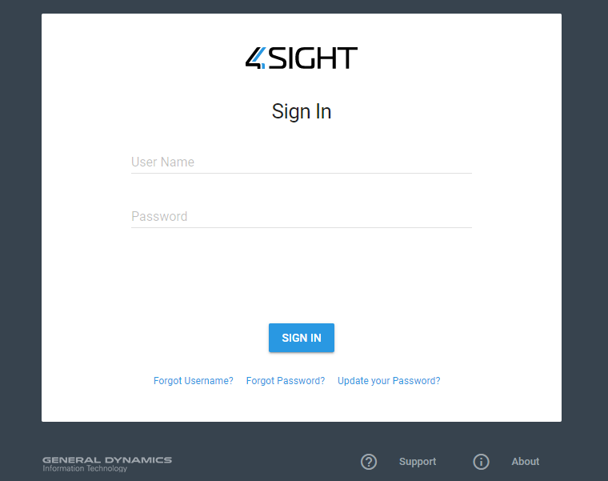
General Navigation | Login Page
Visit https://www.4sightpm-us.com/ to get to the 4Sight homepage
Use your 4Sight username and password
Select Sign In
The login page also has the following prompts in case of any issues. Instructions are provided in the related links on the login page:
Forgot Username?
Forgot Password?
Update your Password?

Slide 6
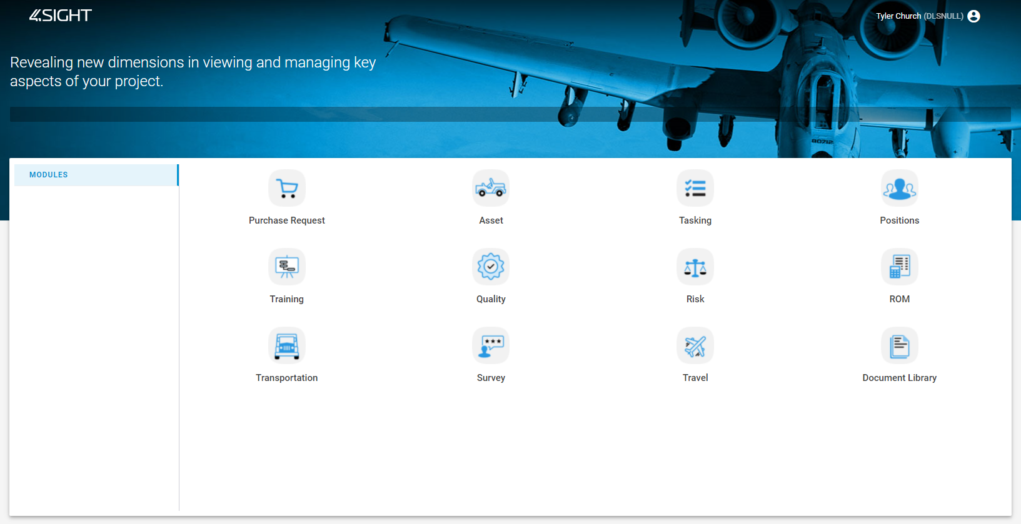


General Navigation | Landing Page
On the right represents the 4Sight landing page. The modules showing on the 4Sight landing page will look different depending on program requirements.

Slide 7
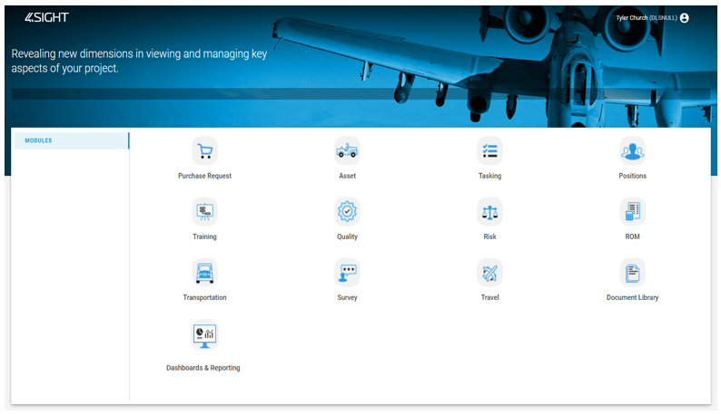
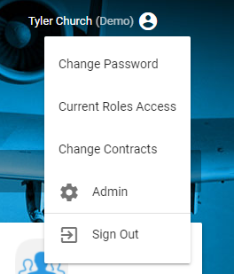
General Navigation | Dropdown Menu
To change your password, see your current roles, change the contract in view, or sign out, select your name in the upper righthand corner to see the dropdown menu.

Slide 8
General Navigation | Elements
Navigation and views in 4Sight are consistent throughout the different modules. This section supports general functionality of 4Sight for the following capabilities
  Editing details
  Adding new records
  Navigating tables
  Searching for information
  Exporting information

Slide 9
General Navigation | Edit Details
Most tables have similar fields and editing capabilities:
Descriptions
Statuses
Additional column(s) for module-specific details
Editing capabilities
Depending on the table, editing details can be done with the Edit Details button, the Edit button, or selecting a hyperlink in the first column of the table. At times, there may be multiple other columns regarding individual records. However, most table functions work the same unless stated otherwise.

Slide 10
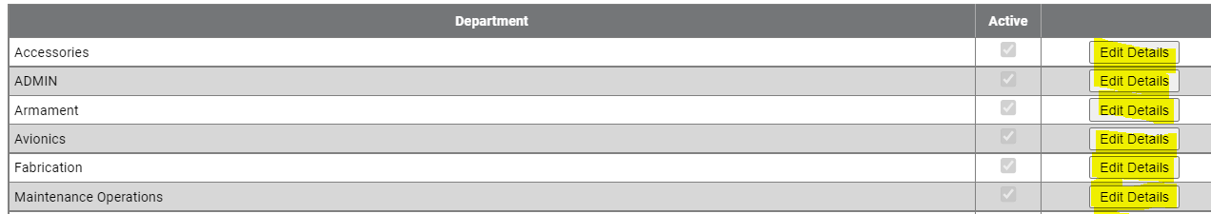
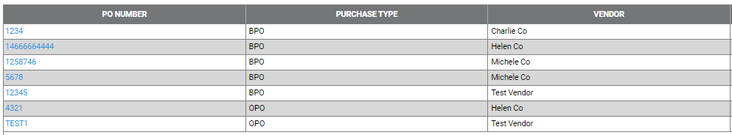
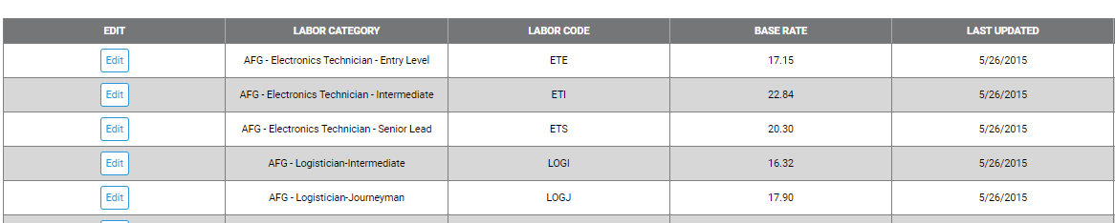
General Navigation | Edit Details
Example of records that require users to click Edit Details next to the line item:
Example of records that require users to click on the blue hyperlink in the first column to edit details:
Example of records that require users to click Edit in the first column to edit details:

Slide 11
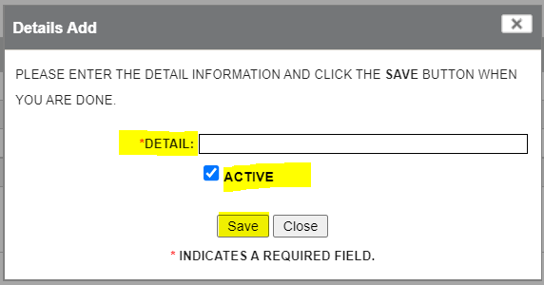
General Navigation | Add New Records
Selecting Add New (or buttons that have different names but function in the same way) in the top corner of most pages can show different new record forms that can have required and optional fields. The red or black asterisks on certain fields in the forms represent required fields. Most forms have dropdowns, checkboxes, and boxes to fill in information. Selecting the Save button after completing the new record is how the new record is added to the list of current records. An example of the new record form can be found below:

Slide 12
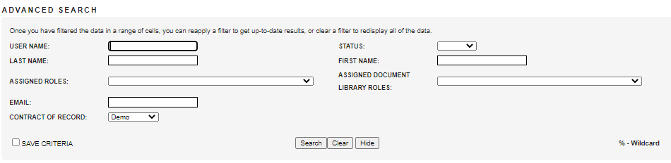
General Navigation | Show Search / Advanced Search
Depending on the table and number of records, selecting Show Search can show an Advanced Search capability where users can narrow the records down in a table by filtering on desired information based on fields. Users can search on specific information by filling out the desired information and selecting Search. To remove any text in the search boxes, users can select Clear in order to start over with a blank canvas for the search. Users can save this information by selecting Save Criteria in order to save their selected search filters. The Hide button simply hides the advanced search.

Slide 13

General Navigation | Additional Functionality
Pages - To go through pages of a table, simply go to the bottom of the table and select the right arrow or left arrow to navigate. Additionally, you can change the number of results per page by selecting the dropdown option for Result Per Page. A user can also go to a specific page by typing in the number on the Go To Page box and selecting Go. See the below screenshot of the fields mentioned:
Export To Function - Gives users the ability to export the information in a table to a PDF, XLS, or CSV.

Slide 14
Purchase Request Module

Slide 15
Purchase Request Module | Icon

Slide 16
Purchase Request Module | Overview
This module is used to create purchase requests (PR) and cost accounting production requests (CAPR).
A tailored workflow enables users to request materials and gain approval for purchases from authorized personnel, then generate a requisition and make available to the buyer for fulfillment. 4Sight provides a way to:
Create purchase requests
Create contract required property requests
Define workflows for requests and approvals
Data is pre-established based on employee sites. Items are easily added to the form and may include attachments. Tailored approval workflow by site/location allows both primary contractor and the customer to participate in the approval process.

Slide 17
Purchase Request Module | Pages
P-Card Reconciliations – Includes reports for All Transactions, Open Transactions, Posted Transactions, Unreceived Transactions, Reconciled Transactions, and Posted To IFS Transactions. These include details on the PR number, vendor, descriptions, buyer, project number, and more.
PRs – Represents views for Open PRs, Closed PRs, and All PRs including their details. Additionally, provides the Property List, including the site name, requisition, PR number, and more information.
My PRs – Shows PRs that have been requested by the person logged in, PRs that the user can take action on, and PRs that are ready for approval by the user.

Slide 18
Purchase Request Module | Pages Continued
Reports – Shows multiple views for purchase request related items and tracking. This includes:
  CDRL Report – Shows CDRLs related to the contract in a table including the site, PR number, PO number, and more.
  CDRL PO Report – Shows purchase orders related to the contract in a table including details related to each individual PO number.
  CDRL PR Report – Shows purchase requests related to the contract in a table including details related to each individual PR number.
  Provides specialized reports such as the 8.3 Materials Incentive Report, BPO/OPO Report, Metric Report, and SWA Logistics Report.
  Provides procurement and financial reports such as Financial Report, Procurement PO Aging Report, and Procurement Report.

Slide 19
Purchase Request Module | Acronyms/Terms
Name | Description
PR | Purchase Request
CTN | Customer Tracking Number
CLIN | Contract Line Item Number
SLIN | Sub-Line Item Number
EDD | Estimated Delivery Date
WO | Work Order
REQ | Request
ORG | Organization
IFS | Industrial and Financial Systems
PO | Purchase Order
NSN | National Stock Number
BPO | Blanket Purchase Order
OPO | Open Purchase Order

Slide 20
Asset Module

Slide 21
Asset Module | Icon

Slide 22
Asset Module | Overview
This module is used to execute asset tracking including the receipt process. This includes:
Listing and auditable tracking of inventory and equipment
Electronic hand receipts
Workflow with electronic signatures
Associate document attachments
In addition to the regular workflow that audit-proofs asset tracking, an electronic hand receipt process from the Property Management Custodian to the accountable employee (hand receipt holder) provides transparency and captures electronic signatures of the hand receipt holders’ acceptance for the items.

Slide 23
Asset Module | Pages
Inventory List – Provides the inventory with inventory date, government approver, and inventory executor. This gives users the ability to add new or edit inventories in the list.
Asset Calibration Due List – Shows the assets with calibration due, including the asset number, description, and other details.
Asset List – Displays the asset list with details on each individual record and the ability to add new assets or edit asset records in the list.
Hand Receipt – Showcases hand receipts with the details and associated custodian filters. This gives users the ability to approve hand receipts and view when the information was signed.
Asset Filter By Approvals – Provides reports for specific filters necessary for viewing information. This includes:
  My Hand Receipt Approvals – Shows a list of approvals for hand receipts from the user logged in.
  Asset My Approvals - Provides a list of approvals for assets from the user logged in.
  Open Assets – Displays a list of open assets based on specific statuses including all details supporting the assets.
  Closed Assets – Displays a list of closed assets that have been approved including their details.
Report -
Asset Filter By Approvals -

Slide 24
Asset Module | Acronyms/Terms
Name | Description
FAR | Federal Acquisition Regulation
TO26 | Task Order 26
TMDE | Test, Measurement, and Diagnostic Equipment
CAL | Calibration
ID | Identification
GOVT. | Government

Slide 25
Tasking Module

Slide 26
Tasking Module | Icon

Slide 27
Tasking Module | Overview
This module provides tasks assigned to users and task approvals. This includes the following capabilities:
Status tracking of opened and closed tasks
Task prioritization and due date assignment
Individual tasks assigned to the logged-in user and tasks awaiting approval from the user

Slide 28
Tasking Module | Pages
Task List – Represents all tasks with the ability to create tasks, edit tasks, filter tasks, and approve tasks. In addition to this, the page also has views for open tasks only and closed tasks only.
My Tasks – Shows tasks that have been created by the person logged in, tasks that are assigned to that person, and tasks that are ready for approval by the user.

Slide 29
Tasking Module | Acronyms/Terms
Name | Description
CTN | Customer Tracking Number

Slide 30
Positions Module

Slide 31
Positions Module | Icon

Slide 32
Positions Module | Overview
People and position data to view staff status for both primary and subcontract employees and support updates for the Training Module. This includes the following capabilities:
Manage job groups and positions
View employee/position and history data
View primary and subcontractor data
Personnel Status (PERSTAT) reporting
HR and Program Management have access to view employee/position and history data, including current position held. This level of employee/position tracking allows a project to ensure staff attains and maintains the correct levels of training and certification to meet customer requirements.

Slide 33
Positions Module | Pages
Personnel Dashboard – Displays data visualizations for position status counts, duty status totals, mission essential personnel identifier totals, and pandemic category counts.
People – Provides views for Active Personnel, Inactive Personnel, and All Personnel for the contract, including related position information and other important details.
Positions – Provides views for Active Positions, Inactive Positions, and All Positions for the contract, including status and details.
Job Groups – Provides views for Active Job Groups, Inactive Job Groups, and All Job Groups with descriptions and statuses.
My Detail – Shows your position and details related to your contract, including job type, position history, and more information.
Reports – Includes reports for visualizing different information. This includes:
  Perstat – Shows current information on personnel that are internal and active users.
  Perstat – Quick Edit - Provides current information on personnel as well as the ability to update data directly from this report.
  Specialized reports for rosters, retention, and security such as the Alpha Roster, Retention Calculation, and Security Events.
  Timely Hiring – Displays information regarding the time taken to fill a position and highlights if such positions have been open for a certain amount of time.

Slide 34
Positions Module | Acronyms/Terms
Name | Description
MEPI | Middle East Partnership Initiative
MI | Middle Initial
EMP | Employee
POS. | Position
CONUS/OCONUS | Continental US / Outside Continental US
DNS | Defense Switched Network
.MIL | Military Email
CAC | Common Access Card
MEPI | Middle East Partnership Initiative

Slide 35
Training Module

Slide 36
Training Module | Icon

Slide 37
Training Module | Overview
This module supports tracking certification standing and training history as well as delivering project training. This includes the following:
Track training requirements and adherence by job category
Manage training assignment and reports for all personnel, including subcontractors
Deliver training to personnel and organize classes
4Sight provides a central solution to manage certifications, licenses, classroom training, external training, computer-based training and job task training. The project defines training requirements and associates those requirements with each employee position. Individuals assigned to positions inherit those training requirements.
The My Training and My Team areas provide either the employee or a manager tailored views of current and required training. This program-centric module allows the user to track training and certification records for both the primary and any subcontractors on the project. 4Sight provides class management tools for instructors who support operations with internal training needs. Notifications and powerful reporting ensure a training program is compliant with contract requirements and on-track.

Slide 38
Training Module | Pages
Training Records – Provides multiple views to see information on personnel and coordinators.
  Under the dropdown, users can view Active Personnel, Inactive Personnel and All Personnel to select individual personnel records to view assigned courses and class schedules in detail.
  Under the dropdown, users can view External People, individuals that are not within the contract. They can also see Internal Training Coordinators and External Training Coordinators to view their records in detail.
Classes – Gives users the ability to sign up for a class on their own in My Sign Up or sign up multiple people for a class under the Multiple People Sign Up.
My Training – Shows training records that require action from the person logged in, including enrolled and overdue training courses, advanced search capability for courses, and acknowledgements for training.

Slide 39
Training Module | Pages
Reports – There are multiple reports that can be used under the training module. These include:
  Reports related to compliance such as the Noncompliant Employees, Charts (Training Status Rollup), and 100% Compliant Employees.
  Reports that show training timeline and coordination information such as Training Due Report, Training Coordinator Report, Training Card, and Training Forecast.
  Reports on class schedule, details, and attendance such as Class Schedule Calendar, Class Schedule w/ Employees, Attendance Detail, No Record Class Detail, and Attendance Summary.
  Training Courses List – Provides a list for specific training courses with the ability to slice and dice the data according to an advanced search.
  Training Report – Provides a list for employee training with the ability to slice and dice the data according to an advanced search.
  Required Courses By... – Shows courses that are required by the job group selected and other search parameters for users to view filtered records and details.
  Employee Sign Off – Displays employee records that have been approved related to the coursework executed including details on the course and class.

Slide 40
Training Module | Acronyms/Terms
Name | Description
EMP. # | Employee Number

Slide 41
Quality Module

Slide 42
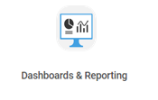

Quality Module | Icon

Slide 43
Quality Module | Quality Module
This module provides ways to manage inspections and audits as well as implement change.
The Quality module’s convenient pipeline dashboard provides inspection planning tools and complete visibility of all active findings with the ability to drill down into the details. Workflow documentation, corrective actions, preventive actions, root cause analysis, and verification of effectiveness are all provided in this module. 4Sight offers the following abilities under this module:
Manage inspections and audits
View list of all active findings
Manage preventative and corrective actions
Track root cause analysis
Perform quality analysis

Slide 44
Quality Module | Pages
Activities - Provides the activities for quality under different views representing standard activities and their current schedule status under the Standard Schedule, PWS activities and their current schedule status under PWS Schedule, and the ability to search schedules and view all activities under Search Activities.
Findings – Lists the findings for quality under different views representing all findings under the Finding Pipeline, the ability to search findings under Search Findings, and external findings including type and source files under External Findings.
My Quality – Shows the quality actions of the user signed into 4Sight. By selecting each category, it will show the associated quality actions.
Reports – Visualizes activity information in the views Activity Report, Activity Summary Report, Activities by Month by Inspector Chart, Activities Scheduled by Date, and Activities Coming Due by Date. Additionally, provides inspections and findings views with Inspection Pass/Fail Report, Findings Report, Findings Summary Report, Findings By Concept, Findings Statistics, and Closed Positive Findings.

Slide 45
Quality Module | Acronyms/Terms
Name | Description
No Acronyms/Terms to identify.

Slide 46
Risk Module

Slide 47
Risk Module | Icon

Slide 48
Risk Module | Overview
This module is used to track risks at the program level. This software module is an easy-to-use, yet comprehensive tool for managing program risks in alignment with company best practices. This module provides:
Risk identification, response and control
Probability and impact modeling supporting contingency budgeting
The Risk module guides end users through the risk management process from identification, risk response, and risk control. Probability and impact inputs are used for determining a contingency reserve budget for the risk.

Slide 49
Risk Module | Pages
Risk Register – Provides the list of risks to add, search, edit, and export.
Risk Dashboard – Visualizes risk data including risks by assessment type, percentage of risks by type, and a status matrix.

Slide 50
Risk Module | Acronyms/Terms
Name | Description
No Acronyms/Terms to identify.

Slide 51
ROM Module

Slide 52
ROM Module | Icon

Slide 53
ROM Module | Overview
This module provides complete cost estimates for customers quickly and easily. A tailored workflow enables users to submit requests for ROMs. Once a ROM request is submitted, the automated process allows contractors to create a ROM and submit it for approval. 4Sight provides the following:
Customer ability to submit ROM requests, track, monitor and approve
Excel templates to create ROMs
Comment tools and threads to track discussions with customer
Easy access worldwide to retrieve ROMs
All calculations automated by location/site
Email alerts
Opened and Closed views, report generation, export to Excel and Print functions
Advanced search function

Slide 54
ROM Module | Pages
ROM List – Lists the ROMs including details and the capability to create new ROMs, edit ROMs, search for ROMs, or Export ROMs.
Filter ROM List – Provides a list of Opened and Closed ROMs in separate views. These can be filtered based on status under Pipeline Filters.
Reports – Lists the reports created for ROM module, which includes the Acceptance Log for the ROMs that have been accepted and closed, the Task Duration Log to track record numbers and timeline details, and the Task Tracker for tracking tasks and statuses.

Slide 55
ROM Module | Acronyms/Terms
Name | Description
CTN | Customer Tracking Number
POP | Period of Performance
ROM | Rough Order of Magnitude
CAT | Category
REC’D | Received
PCO | Project Control Office
GOV | Government

Slide 56
Transportation Module

Slide 57
Transportation Module | Icon

Slide 58
Transportation Module | Overview
This module is a program solution that was developed for automating shipment reports. This provides:
Automated real-time transportation reports viewable by GDIT and customer
Email alerts (that include DD1149 form attachments) to notify POC of incoming shipment
Automated DD1149 forms generated through and stored in the system
Transparent transactions, as users can check on the status of shipments at any time
Receipt views for opened and closed receipts
Ability for tracking of all shipments
Advanced search function
Data is pre-established based on employee site. Items are easily added to the form and may include attachments. This provides automated transportation reports that are updated in real time. These can be viewed by both GDIT and Government customers, adding transparency and access to real-time status updates.

Slide 59
Transportation Module | Pages
Shipment List – Provides a list of shipments with the ability to filter, search and export the data. This also allows users to create shipments and create receipts.
Shipment – Provides users with views to a faster way of creating records under Create Shipment and Create Receipt.
Catalog – Shows views for items that belong under the catalog for transportation.
  View Catalog – Displays catalog items that have been approved including additional details.
  Items Awaiting Approval – Shows items that are currently awaiting approval to be added to the catalog.
  Deleted Items – Displays catalog items were deleted under any circumstance. These items can be restored in this view.
Transportation Dashboard – Visualizes transportation data including total shipments within the month, shipments per site, priority, metrics, days to ship, and more performance indicators. These can be filtered on timeframe and RSC specifics.

Slide 60
Transportation Module | Pages Continued
Reports – Displays different views for transportation. These reports include:
  Transportation Report – Shows individual transportation items and details with the ability to search, filter, and export the information.
  Export Shipment Log – Displays shipment log number records including details to export the information.
  Timeline Report – Provides arrival and shipment of items with tracking numbers, carriers, and other details related to timeline tracking.
  Specialized reports such as the SITREP Report and SWA Logistics Report.
  RMA Report – Provides RMA records report details with the ability to search, filter, and export the information.

Slide 61
Transportation Module | Acronyms/Terms
Name | Description
RSC | Regional Support Center
TCN | Third Country National
SN | Serial Number
POC | Point of Contact
RMA | Return Merchandise Authorization
REQ | Requisition
SWA | Southwest Asia
DODAAC | Department Of Defense Activity Address Code
REC | Need some context on this one. If I can see where it is, I may know it.
NO | Number
PO# | Purchase Order Number
NSN | National Stock Number
ECCN | Export Control Classification Number
USML | U.S. Munitons List
HTS | Harmonized Tariff Schedule
MILAIR | Military Air
ITO | Installation Transportation Office
SITREP | Situation Report

Slide 62
Transportation Module | Acronyms/Terms Continued

Slide 63
Survey Module

Slide 64
Survey Module | Icon

Slide 65
Survey Module | Overview
This module is utilized to collect feedback to verify best practices and identify needed improvements for continuous product improvement. This includes the following:
Collect customer or end user feedback
Easy access worldwide to submit feedback
Provide task order staff with survey responses in electronic format for data collection and analysis
Give the customer the option to complete in private and email form to QAM and/or the email addresses provided by contractor
Send an email alert to the QAM when there is a survey completed with low ratings

Slide 66
Survey Module | Pages
Survey List – Provides the list of surveys, in which users can create new surveys, filter, export, and search for surveys within the list. The details in the surveys include the sites associated, the type, completion status, and more targeted information.
Reports – Displays the Survey Report, which shows all surveys available, with the ability to search, export, and filter the report.

Slide 67
Survey Module | Acronyms/Terms
Name | Description
MR | Market Research
Q1 | Quarter 1

Slide 68
Travel Module

Slide 69
Travel Module | Travel Module

Slide 70
Travel Module | Overview
This module supports tracking travel requests and itineraries with customer approval mechanisms. This includes the following capabilities:
Create travel requests and detailed itineraries
Charge travel to proper funding lines and ensure funding is available with "checkbook" function
Compliance with FEDSIM requirements
Customer approval workflow
Travel requests are easily created and may include attachments. Tailored approval workflow by site/location allows both contractor and customer to participate in the approval process. The FEDSIM approved TAR (Travel Authorization Request) form that is generated can be exported and attached to any travel system to show that approval of travel and associated expenses has been approved.

Slide 71
Travel Module | Pages
Report – Shows a Travel Report with a list of travel requests include TAR details and the ability to search, filter, and export the list.
Travel Requests List – Shows the list of travel requests including TAR number, sites, destinations, requestors, and other details. Users can add new travel requests as well as search, filter, and export the table.
Filter Requests List – Provides views for Open Requests and Closed Requests related to travel including details on each record.
My Approvals - Shows TARs that have been requested by the person logged in, rejected TARs, and tasks that are ready for approval by the user.

Slide 72
Travel Module | Acronyms/Terms
Name | Description
TAR | Travel Authorization Request
CTN | Customer Tracking Number
CLIN | Contract Line Item Number
LOA | Letter of Authorization
SLIN | Sub-Contract Line Item Number
MOD | Modification
ROM | Rough Order of Magnitude

Slide 73
Document Library

Slide 74
Document Library | Icon

Slide 75
Document Library | Overview
This module gives users the ability to download working drafts or delivered documents. It provides access to libraries and modules based on role(s) and position(s), which allows private libraries for certain credentials. This includes:
Public/private folder structure
Store contract deliverables
Subscribe to updates
Team access for All CDRLs (Contract Deliverables) and other ad hoc reports are resident in the Document Library.
Public and private libraries - Flexible configuration allows Libraries to be set so only users provided access can view and download documents.
Users may choose to subscribe to libraries or folders within a library and will receive email alerts when a new document is uploaded.
Users worldwide can access the libraries 7 days a week, 24 hours a day.

Slide 76
Document Library | Acronyms/Terms
Name | Description
ROM | Rough Order of Magnitude
PR | Purchase Request
PO | Purchase Order
Avg. | Average
COR | Contracting Officer’s Representative
PCO | Project Control Office
COTR/TPOC | Contracting Officer’s Technical Representative / Technical Point of Contract
FEDSIM COR | Federal Systems Integration & Management Center Contracting Officer’s Representative

Slide 77
Dashboards & Reporting Module

Slide 78
Dashboards & Reporting Module | Icon

Slide 79
Dashboards & Reporting Module | Overview
This module expands on 4Sight’s current offerings and provides dashboard solutions to programs with up-to-date tools. This add-on service for 4Sight provides complex and integrated dashboards based on 4Sight data and modules. Dashboard solutions are categorized under the same names as their respective modules. This gives users the ability to see all dashboard offerings in one place. 4Sight leverages Tableau to develop data visualizations.

Slide 80
Dashboards & Reporting | Acronyms/Terms
Name | Description
D&R | Dashboards & Reporting

Slide 81
Additional Information

Slide 82
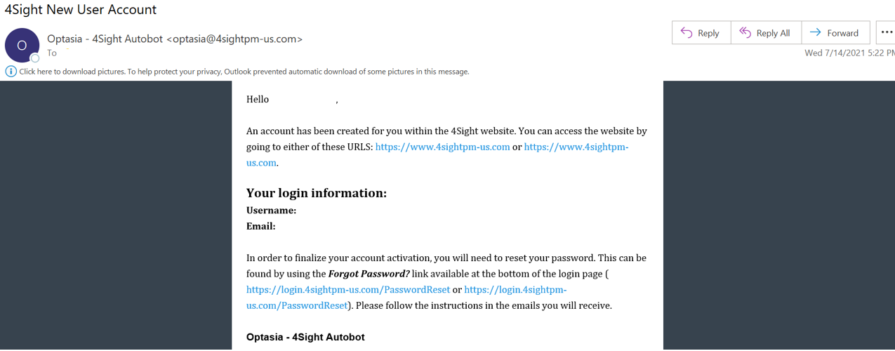
Account Setup
To request access to an account, reach out to your 4Sight Contract Administrator.
Your account information will be sent from Optasia (optasia@4sightpm-us.com) with instructions on how to activate your account.
  The email will be titled “4Sight New User Account.”

Slide 83
Notifications from Optasia
Optasia (optasia@4Sightpm-us.com) is the account used for global communications to all 4Sight users. Announcements such as outages, password changes, scheduled maintenance, sprint releases, and other important communications will be provided from this email. Users should look out for information from this account on any issues or important announcements that may affect their day-to-day work in 4Sight.

Slide 84
Escalations
Users should escalate the following inquiries/issues to their 4Sight Contract Administrators:
Getting access to 4Sight
Receiving proper roles
Uploading information to accessible modules
Users should escalate the following issues to 4Sight Support at 4Sight@gdit.com
Bugs/small issues with 4Sight
Immediate changes needed, such as additional existing fields to a table
4Sight outages (when the application is throwing an error when on the welcome page)
Broken links to pages
Locked out of 4Sight account

